Slide 1

Right of Way Move Planning for Transportation Projects
By Florence green, SR/WA, r/w-rac &
Sarah Boggs, SR/WA-TN, r/w-rac

Slide 2

Purpose of the Presentation
Understand move planning fundamentals
Identify coordination needs across project teams
Apply practical strategies for successful relocations

Slide 3
What Is Move Planning?
Preparation for residential and business relocations
Sequencing activities to support project schedules
Reducing disruption for affected occupants

Slide 4
Core Elements of Move Planning
Occupant interviews and needs assessment
Scheduling, phasing, and milestone tracking
Communication and documentation

Slide 5

Best Practices
Start early
Document consistently
Communicate often
Adapt to changing conditions

Slide 6

Coordination with Project Teams
Engineering and construction schedules
Acquisition and property management interfaces
Stakeholder communication

Slide 7
Advisory Services
Pre-Displacement Interview
Explanation of Benefits
Establishing Rapport

Slide 8
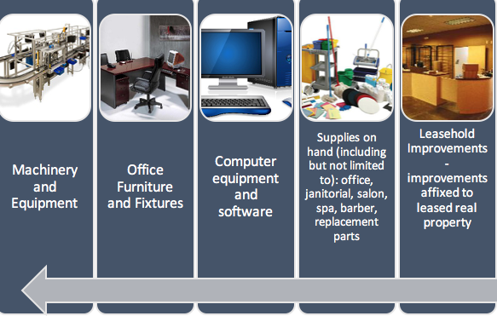

Identifying Personal Property EARLY

Slide 9
Analyzing the Need
Inspections
Inventory
Choosing Vendors

Slide 10
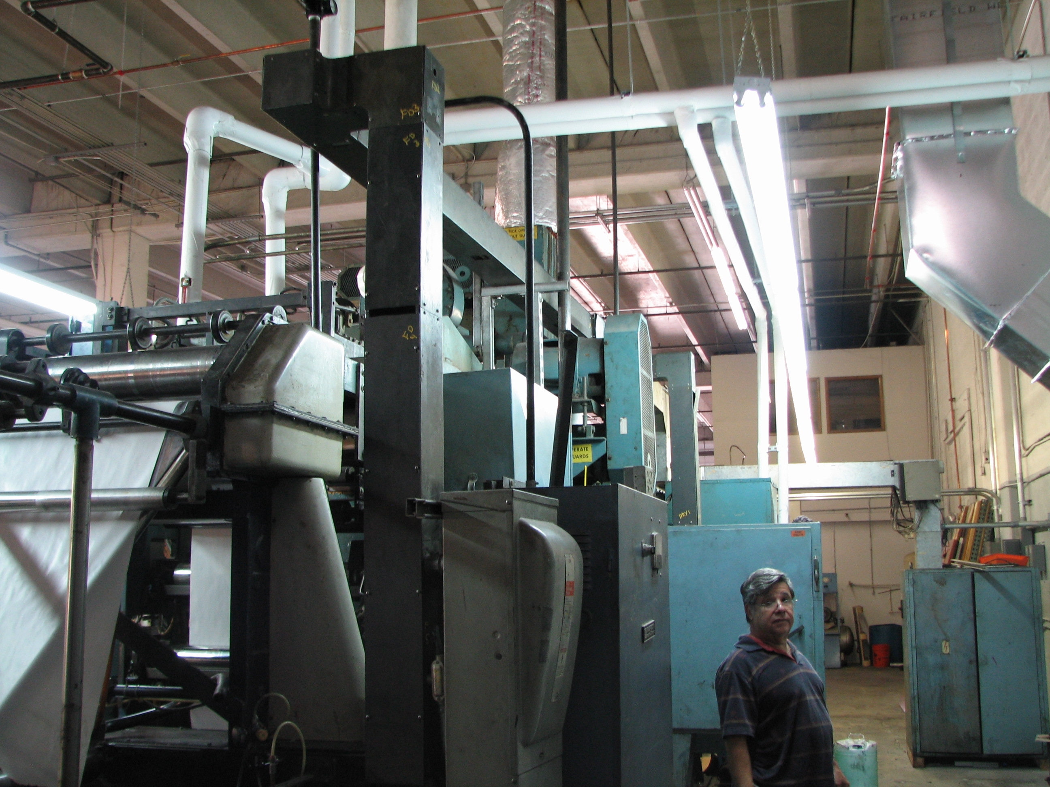
Challenges of
Non-Residential BIG MOVES
Manufacturing Facility

Slide 11

Challenges of Non-Residential
BIG MOVES
Storage Facilities

Slide 12

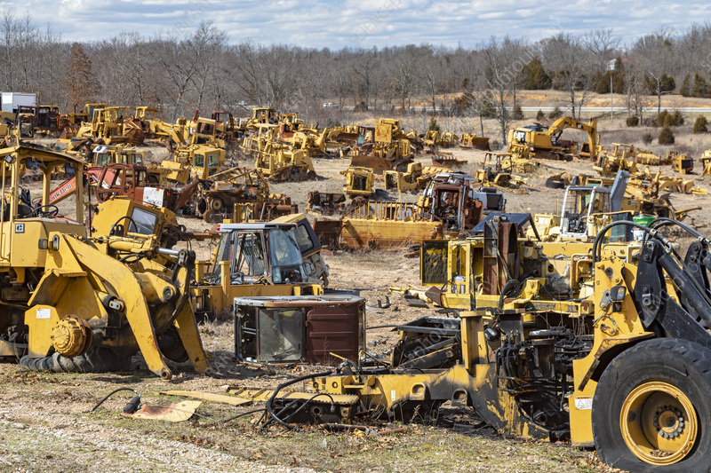
Challenges of Non-Residential BIG MOVES
Salvage Yards

Slide 13
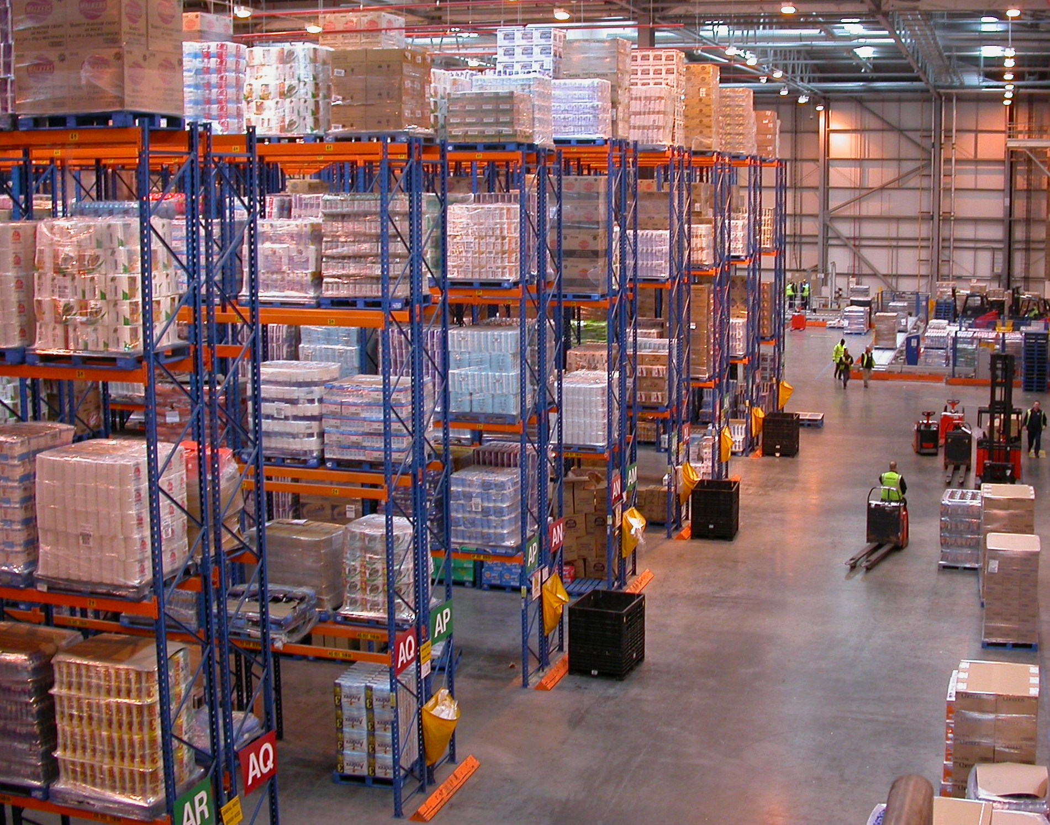
Challenges of
Non-Residential BIG MOVES
Factory Distribution

Slide 14
Developing the Scope
Planning – What is necessary
Schedule
Complexity
Vendor Availability

Slide 15
Best Practices
Make all efforts to obtain move quotes
Determine Bids vs Estimates
Best when scope is fully known
Best when scope is flexible

Slide 16

Challenges of the Commercial BIG MOVE
Inventory
Hookups
Communication
Time Management

Slide 17

Challenges of the Self BIG MOVE
Replacement sites
Business self move based on the lower of 2 estimates
Actual Cost Move

Slide 18

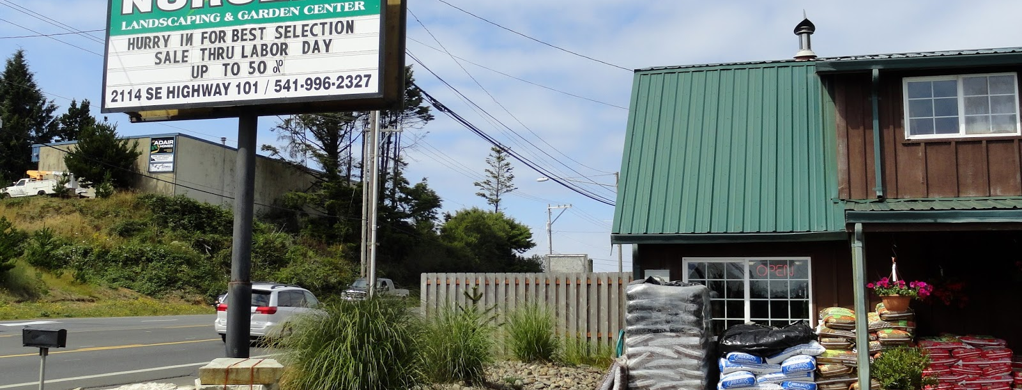
Challenges of the Personal Property BIG MOVE
moves onto the remainder

Slide 19

Monitor the Move
Personally Monitor
Coordinate with Movers & Displacee

Slide 20
Do I Need A Move Planner?
Is this a complex move?
Is there a compressed timeframe?
What planning is needed?
Coordination with your agency

Slide 21

Do I Need A Move Planner
When do I call?
Execution

Slide 22
Selection of Move Planner
Qualifications
Expertise
Cost Control

Slide 23

Residential Big Moves By Definition

Slide 24

Challenges of the Residential BIG MOVE
Assisted Living Facility

Slide 25
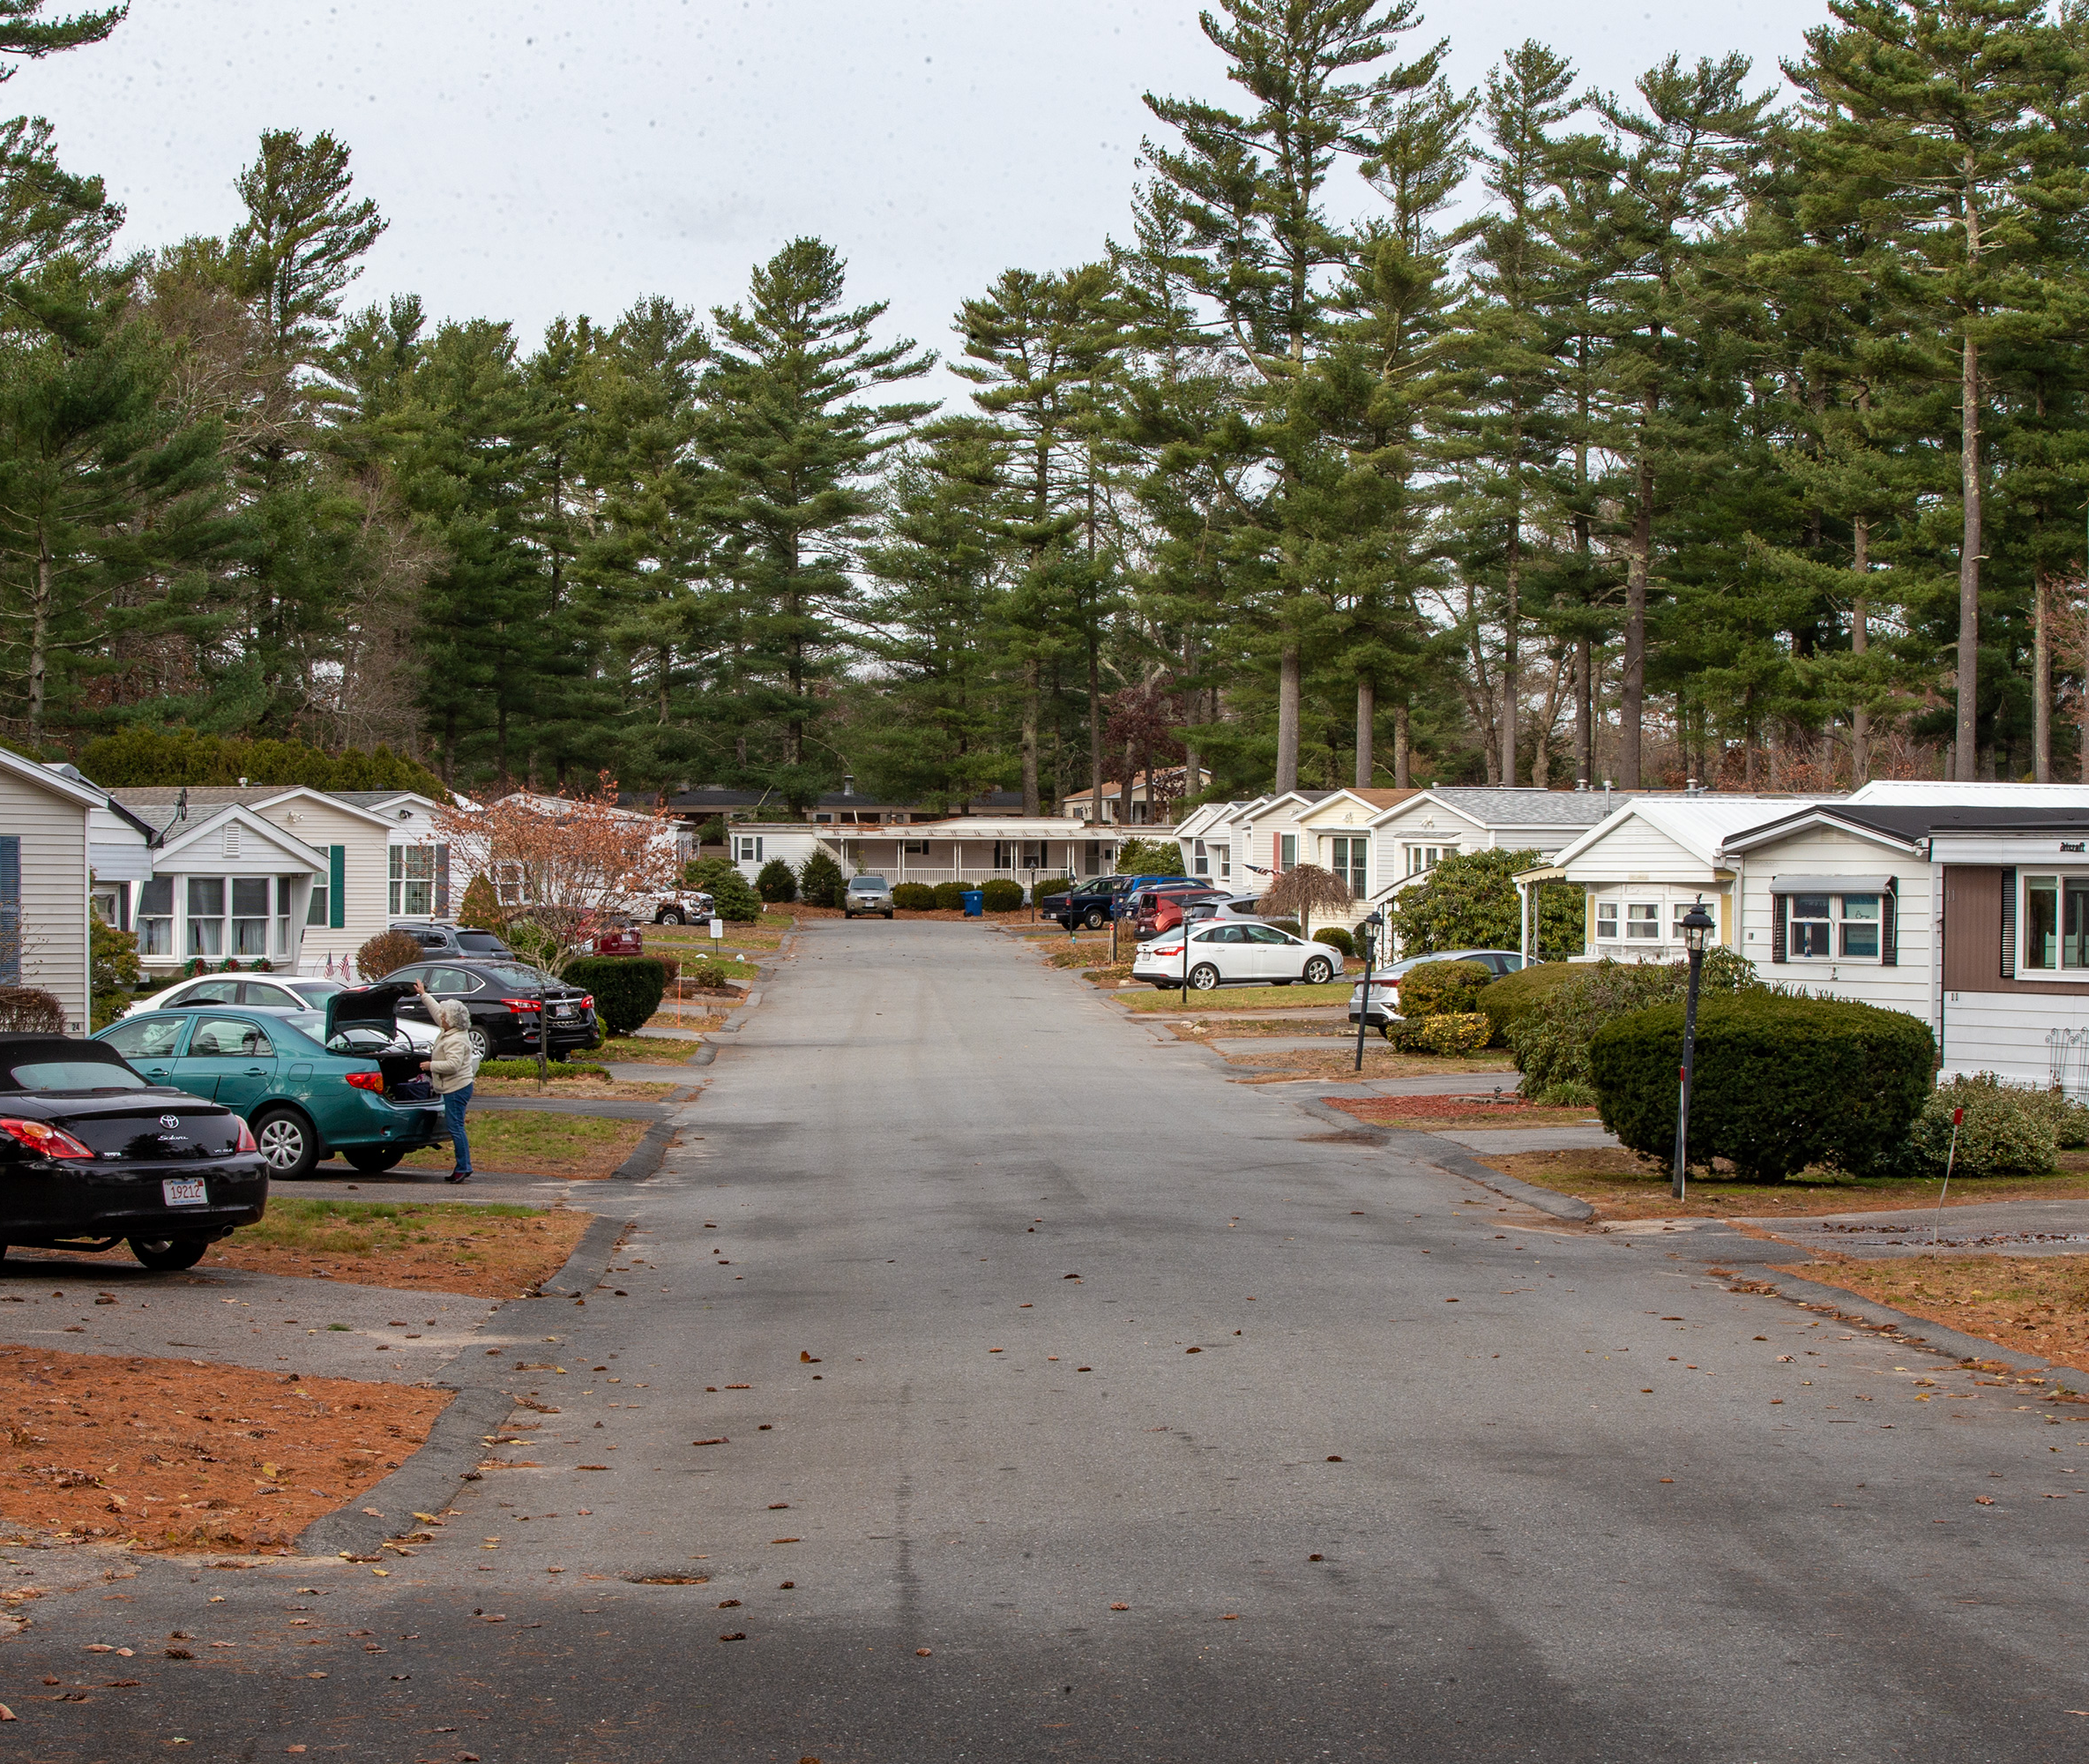
Challenges of the Residential BIG MOVE
Mobile Home Park

Slide 26

Challenges of the Residential
BIG MOVE
Apartment Complex

Slide 27

Challenges of the Residential
BIG MOVE
Mansion / Large homes

Slide 28
Complications
Attorneys
Move Planner Solicitation
Uninformed Displacee
Undefined Scope
Uninformed Move Planner
Non-Agency Approval
Time Delays

Slide 29
Risks of Poor Planning
Project delays
Increased costs
Occupant dissatisfaction and claims

Slide 30

Summary Recommendations
Develop Scope of Services
Identify Specialty Equipment
Seek Concurrence
Obtain Estimates
Consultations with Displacee

Slide 31
Thank you!
/
Florence Green, SR/WA, R/W-RAC
Senior Right of Way & Utilities Manager, Atkins Realis
Sarah Earls-Boggs, SR/WA-TN R/W-RAC
Project Manager, Florida Acquisition & Appraisal Inc.

