Slide 1
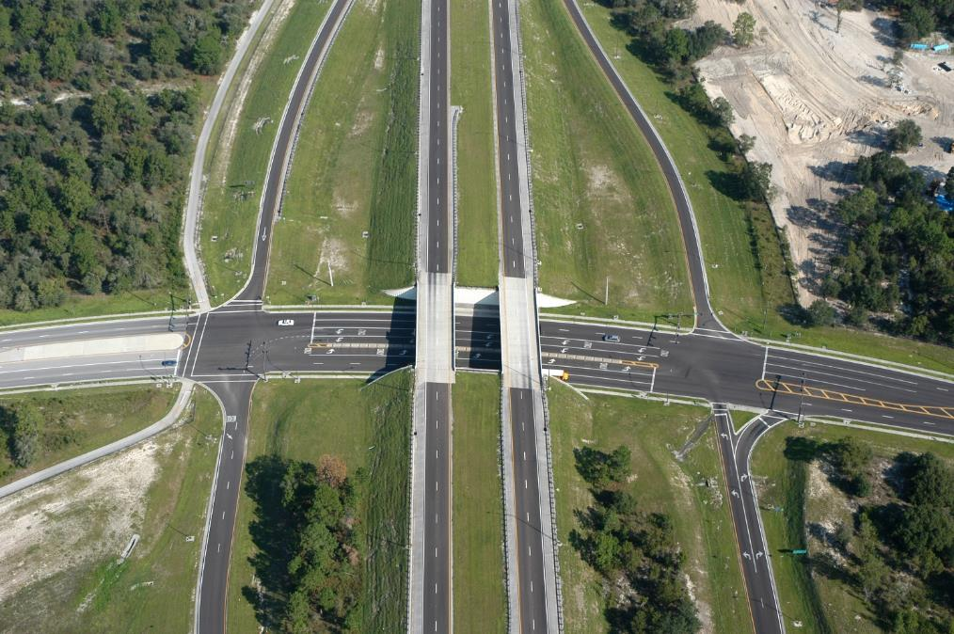
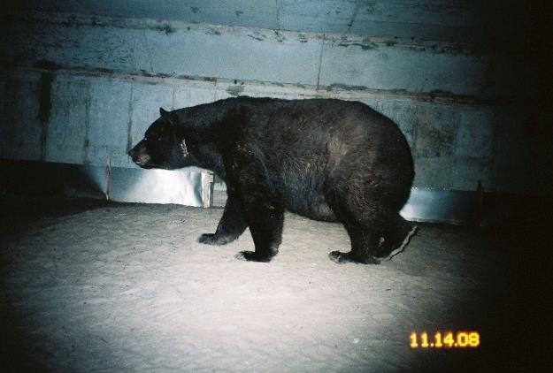
IRWA-ITC Symposium
April 30, 2026
Conservation Acquisitions:
What Acquisition Agents Need to Know

Slide 2


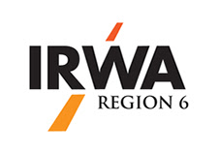




Presented by
Wendi McAleese, President
American Government Services Corporation

Slide 3

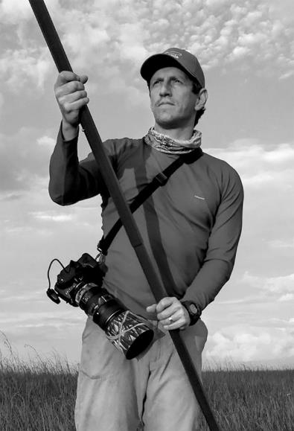
Photography by:
www.carltonward.com

Slide 4
What Drives Conservation?

Slide 5
Net Population Change
States with largest recent net positive growth
Florida
Texas
South Carolina
North Carolina
Georgia

Slide 6
Conservation Programs Used in Region 6
Georgia
2026 Allocation-$33M
Georgia Outdoor Stewardship Act (GOSA)
Georgia Land Conservation Program
Georgia Conservation Tax Credit Program
Georgia Farmland Conservation Fund Program
Tennessee
2025 balance $25M
Tennessee Wildlife Resources Agency
Tennessee Heritage Conservation Trust Fund
Tennessee Wetlands Acquisition Fund
Alabama
Annual-$15M
Forever Wild Land Trust Program
Alabama Soil and Water Conservation Committee
Alabama Forestry Commission Programs

Slide 7
Conservation Programs Used in Region 6
North Carolina
Tax Credits
Wildlife Conservation Land Program
Natural Heritage Program
North Carolina Land and Water Fund
South Carolina
Tax Credits
South Carolina Department of Environmental Services
Land and Water Conservation Fund
LandYield
Mississippi
Owner Resources
Mississippi Land Conservation Assistance Network
Mississippi Department of Wildlife, Fisheries and Parks
Mississippi Land Trust

Slide 8
Conservation Programs Used in Region 2
Texas
2017-$2 M
Texas Farm and Ranch Lands Conservation Program
Land Conservation Assistance Network
Louisiana
2024-$26 M
Louisiana Department of Wildlife and Fisheries
Louisiana Duck Stamp Fund
Louisiana Wildlife Habitat and Natural Heritage Trust Fund
Arkansas
2025-$8 M
Arkansas Game and Fish Commission
Arkansas State Parks
Arkansas Natural Heritage Commission

Slide 9
Conservation Programs Used in Region 9
Colorado
Tax Credits
Colorado Open Lands
Conservation Colorado
Colorado State Conservation Board
New Mexico
2023-$100 M
Natural Heritage Conservation Act
New Mexico State Parks
New Mexico Department of Game and Fish
30x30 Initiative
Land of Enchantment Legacy Fund
Utah
2025-$7 M
UDAF Land Conservation Program
Critical Agriculture Land Conservation Fund
Utah Open Lands

Slide 10
Conservation Programs Used in Region 9
Oklahoma
Cost-share/Tax Credits
Oklahoma Department of Wildlife Conservation
Oklahoma Association of Conservation Districts
Mexico
2025-$17 M
National Commission of Natural Protected Areas
MEx30x30
Sonora’s Derecho Real de Conservacion (Real Right of Conservation)
Mexico Conservation Finders

Slide 11
Conservation Programs Used in Florida
1990–1999
Preservation 2000
$300 million per year for 10 years
Fee simple or conservation easements
2000 – Present
Florida Forever
Originally $300 million per year
Fee simple or conservation easements
2008 – Present
Rural & Family Lands Protection Program
Variety of USDA conservation easement programs
US Forest Service, US Fish & Wildlife Service

Slide 12
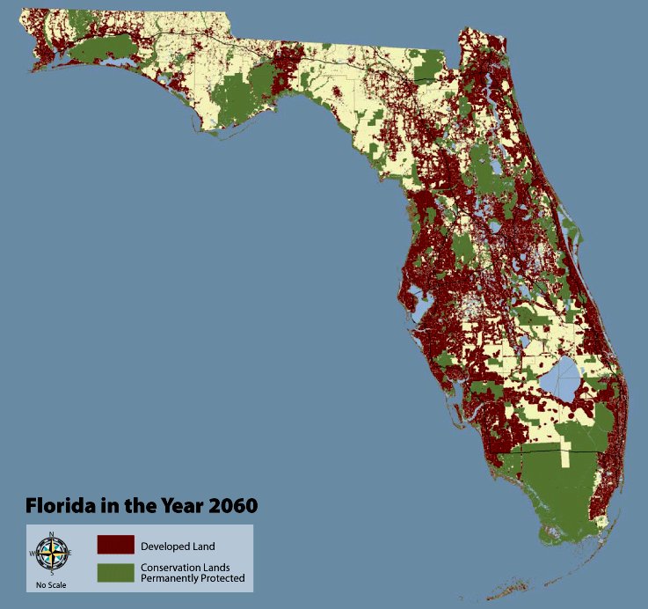
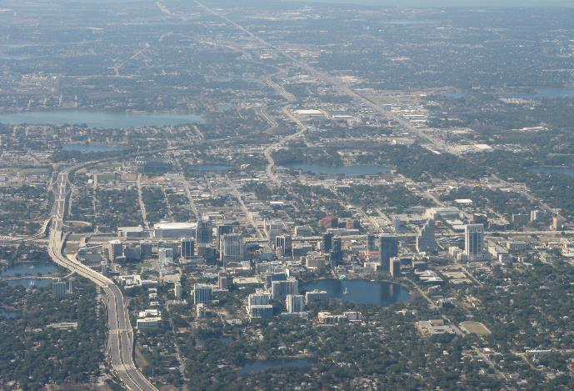
1000 Friends of Florida

Slide 13
Florida’s Imperiled Species
131 Federal or State Listed Animal Species
Florida Panther
Florida Key Deer
Gopher Tortoise
American Crocodile
Wood Stork
69 Federally Listed Plant Species
20 are found on the Lake Wales Ridge

Slide 14
Florida Conservation
By The Numbers
Total Florida land area 34,320,000 acres
Total managed for conservation 10,786,209 acres
Federal lands 4,069,977 acres
State lands 5,011,239 acres
Local government lands 502,744 acres
Private lands 236,332 acres
Conservation easements 965,917 acres

Slide 15
Transportation and Conservation
Working Together

Slide 16
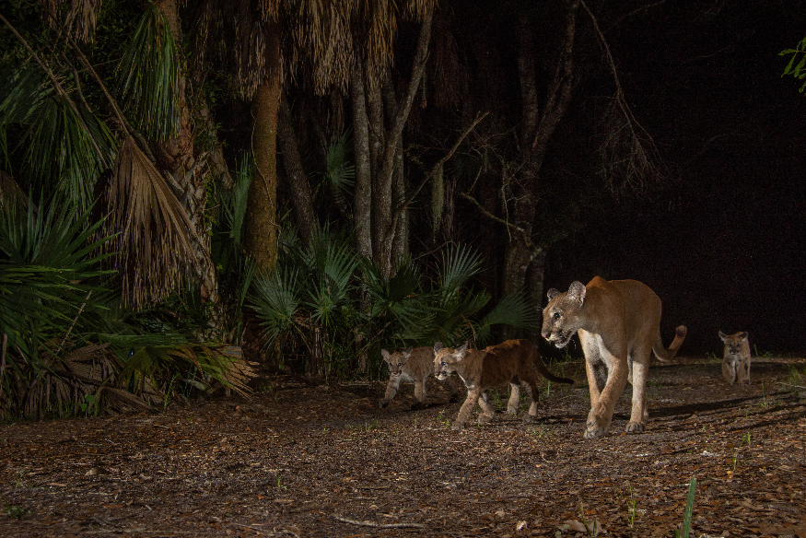
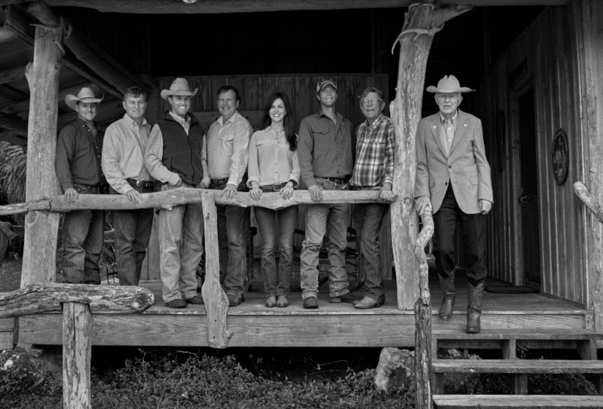
The Impact of Regional Roads
New roads can:
Destroy species habitat and productive agricultural land
Fragment wildlife corridors and increase road kills
Impact the ability to conduct prescribed fires
Increase urban sprawl; changing rural way of life
Increase speculative land buying
© Randy Bautista
© Carlton Ward

Slide 17
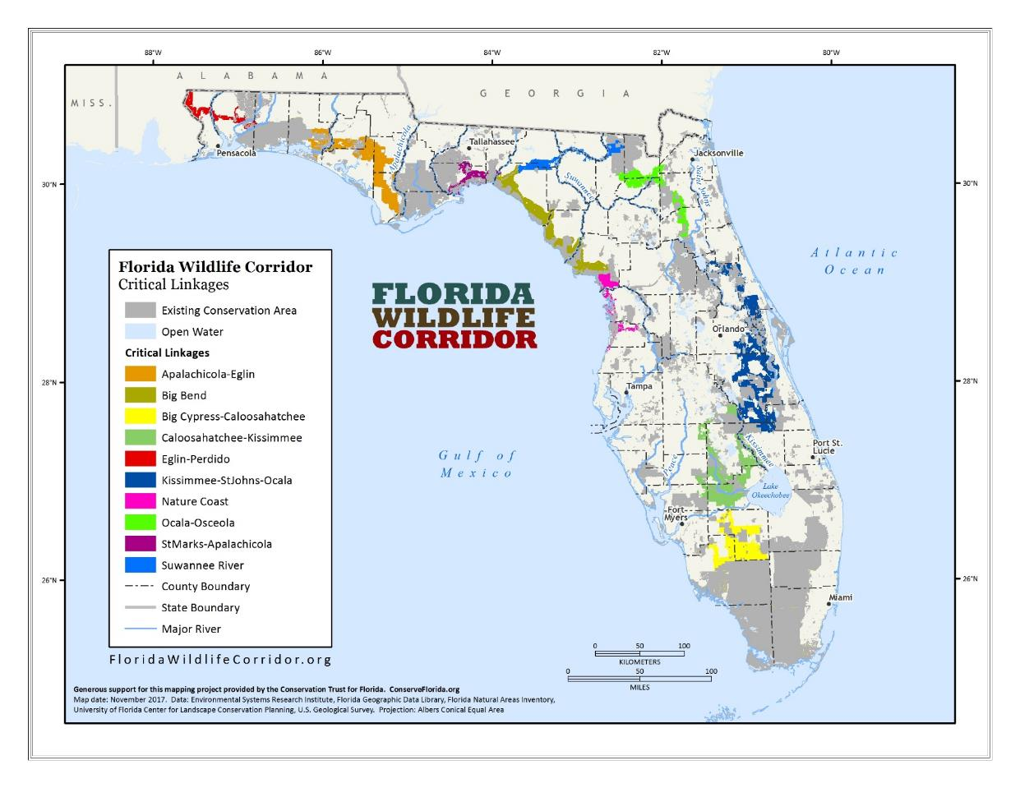
Florida Wildlife Corridor 2017

Slide 18
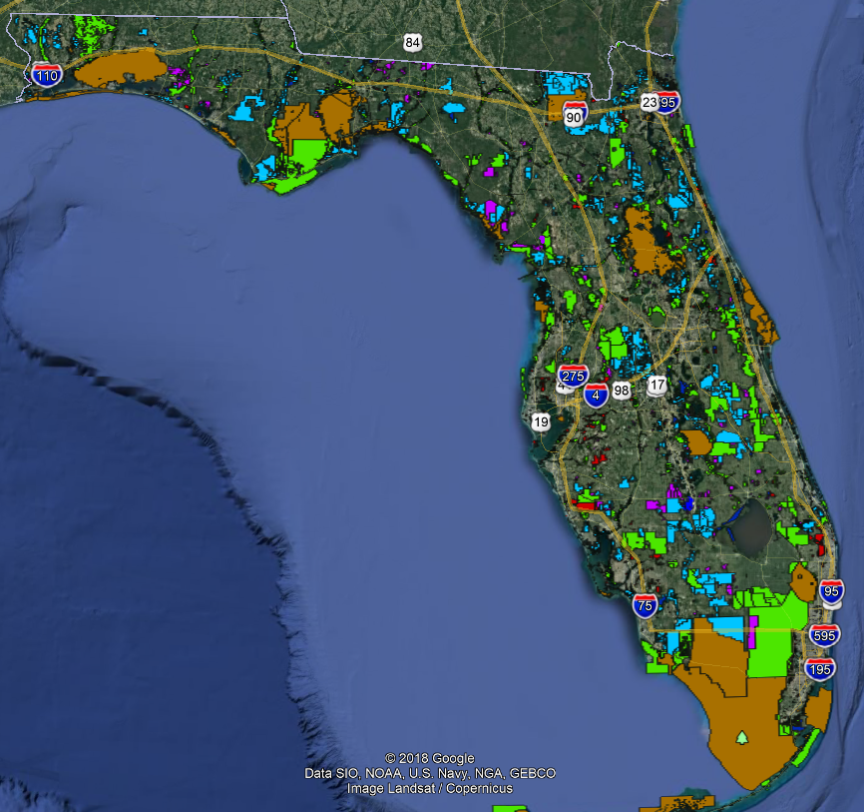
Conservation Lands
& Projects

Slide 19
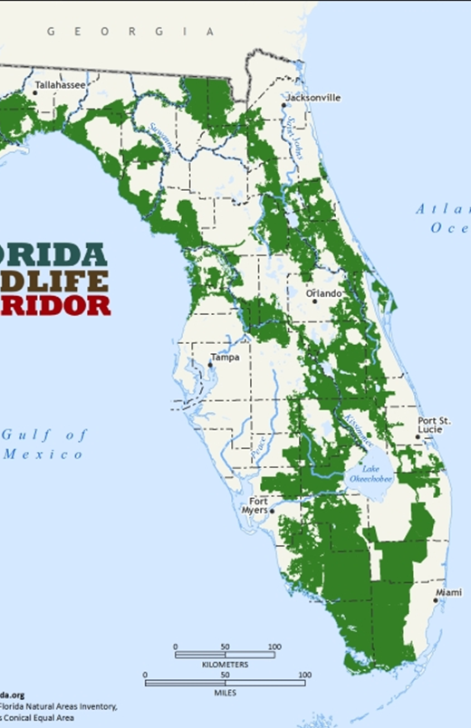
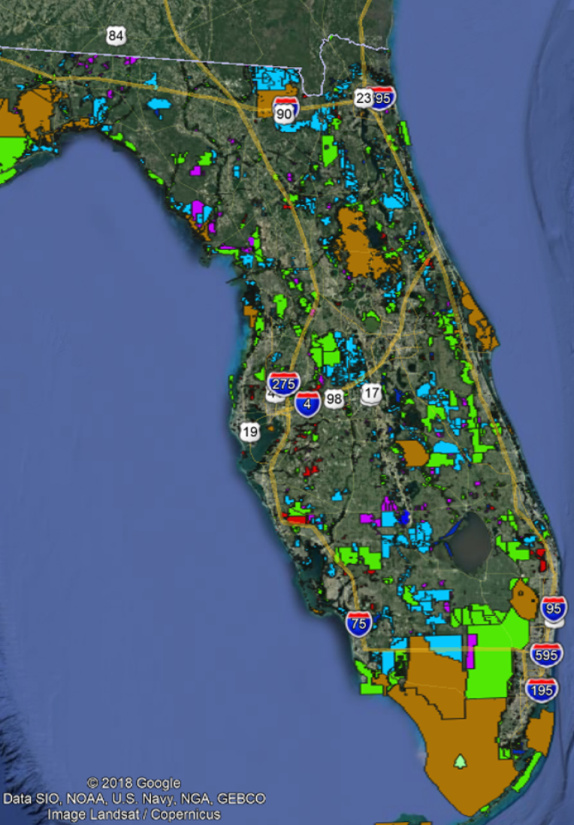

Slide 20
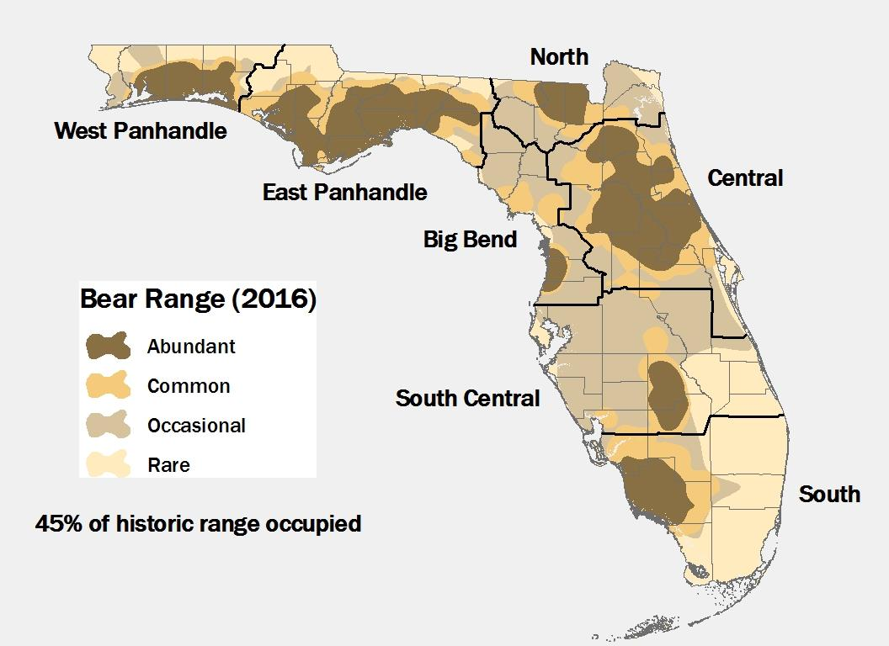
Florida Black Bear

Slide 21
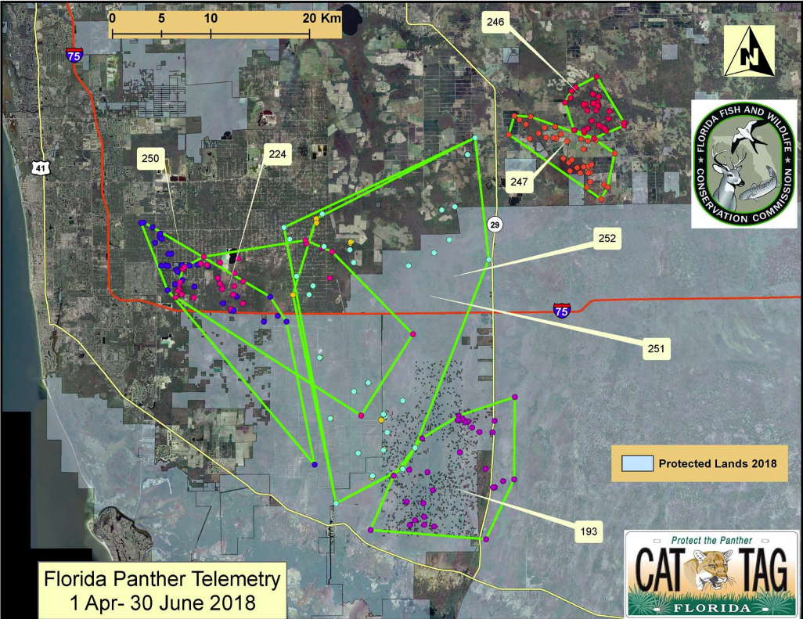
Florida Panther Telemetry 2018

Slide 22
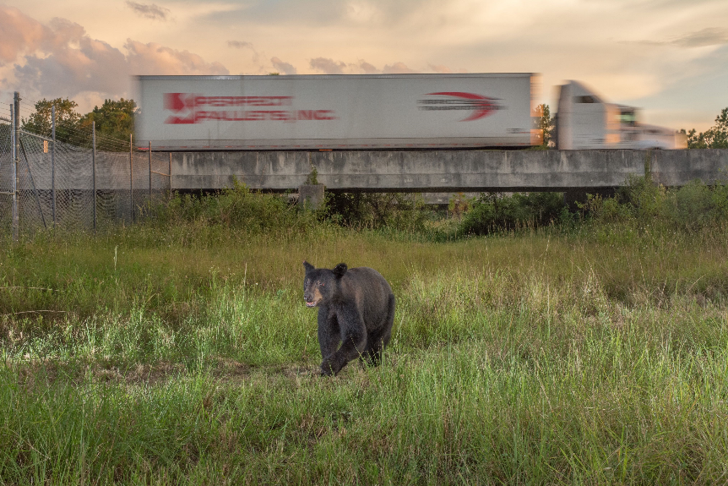
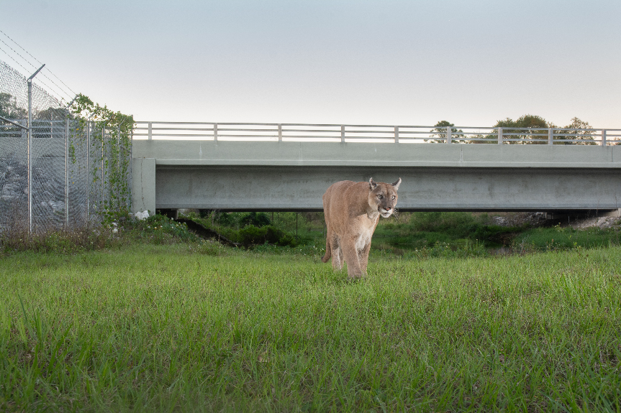
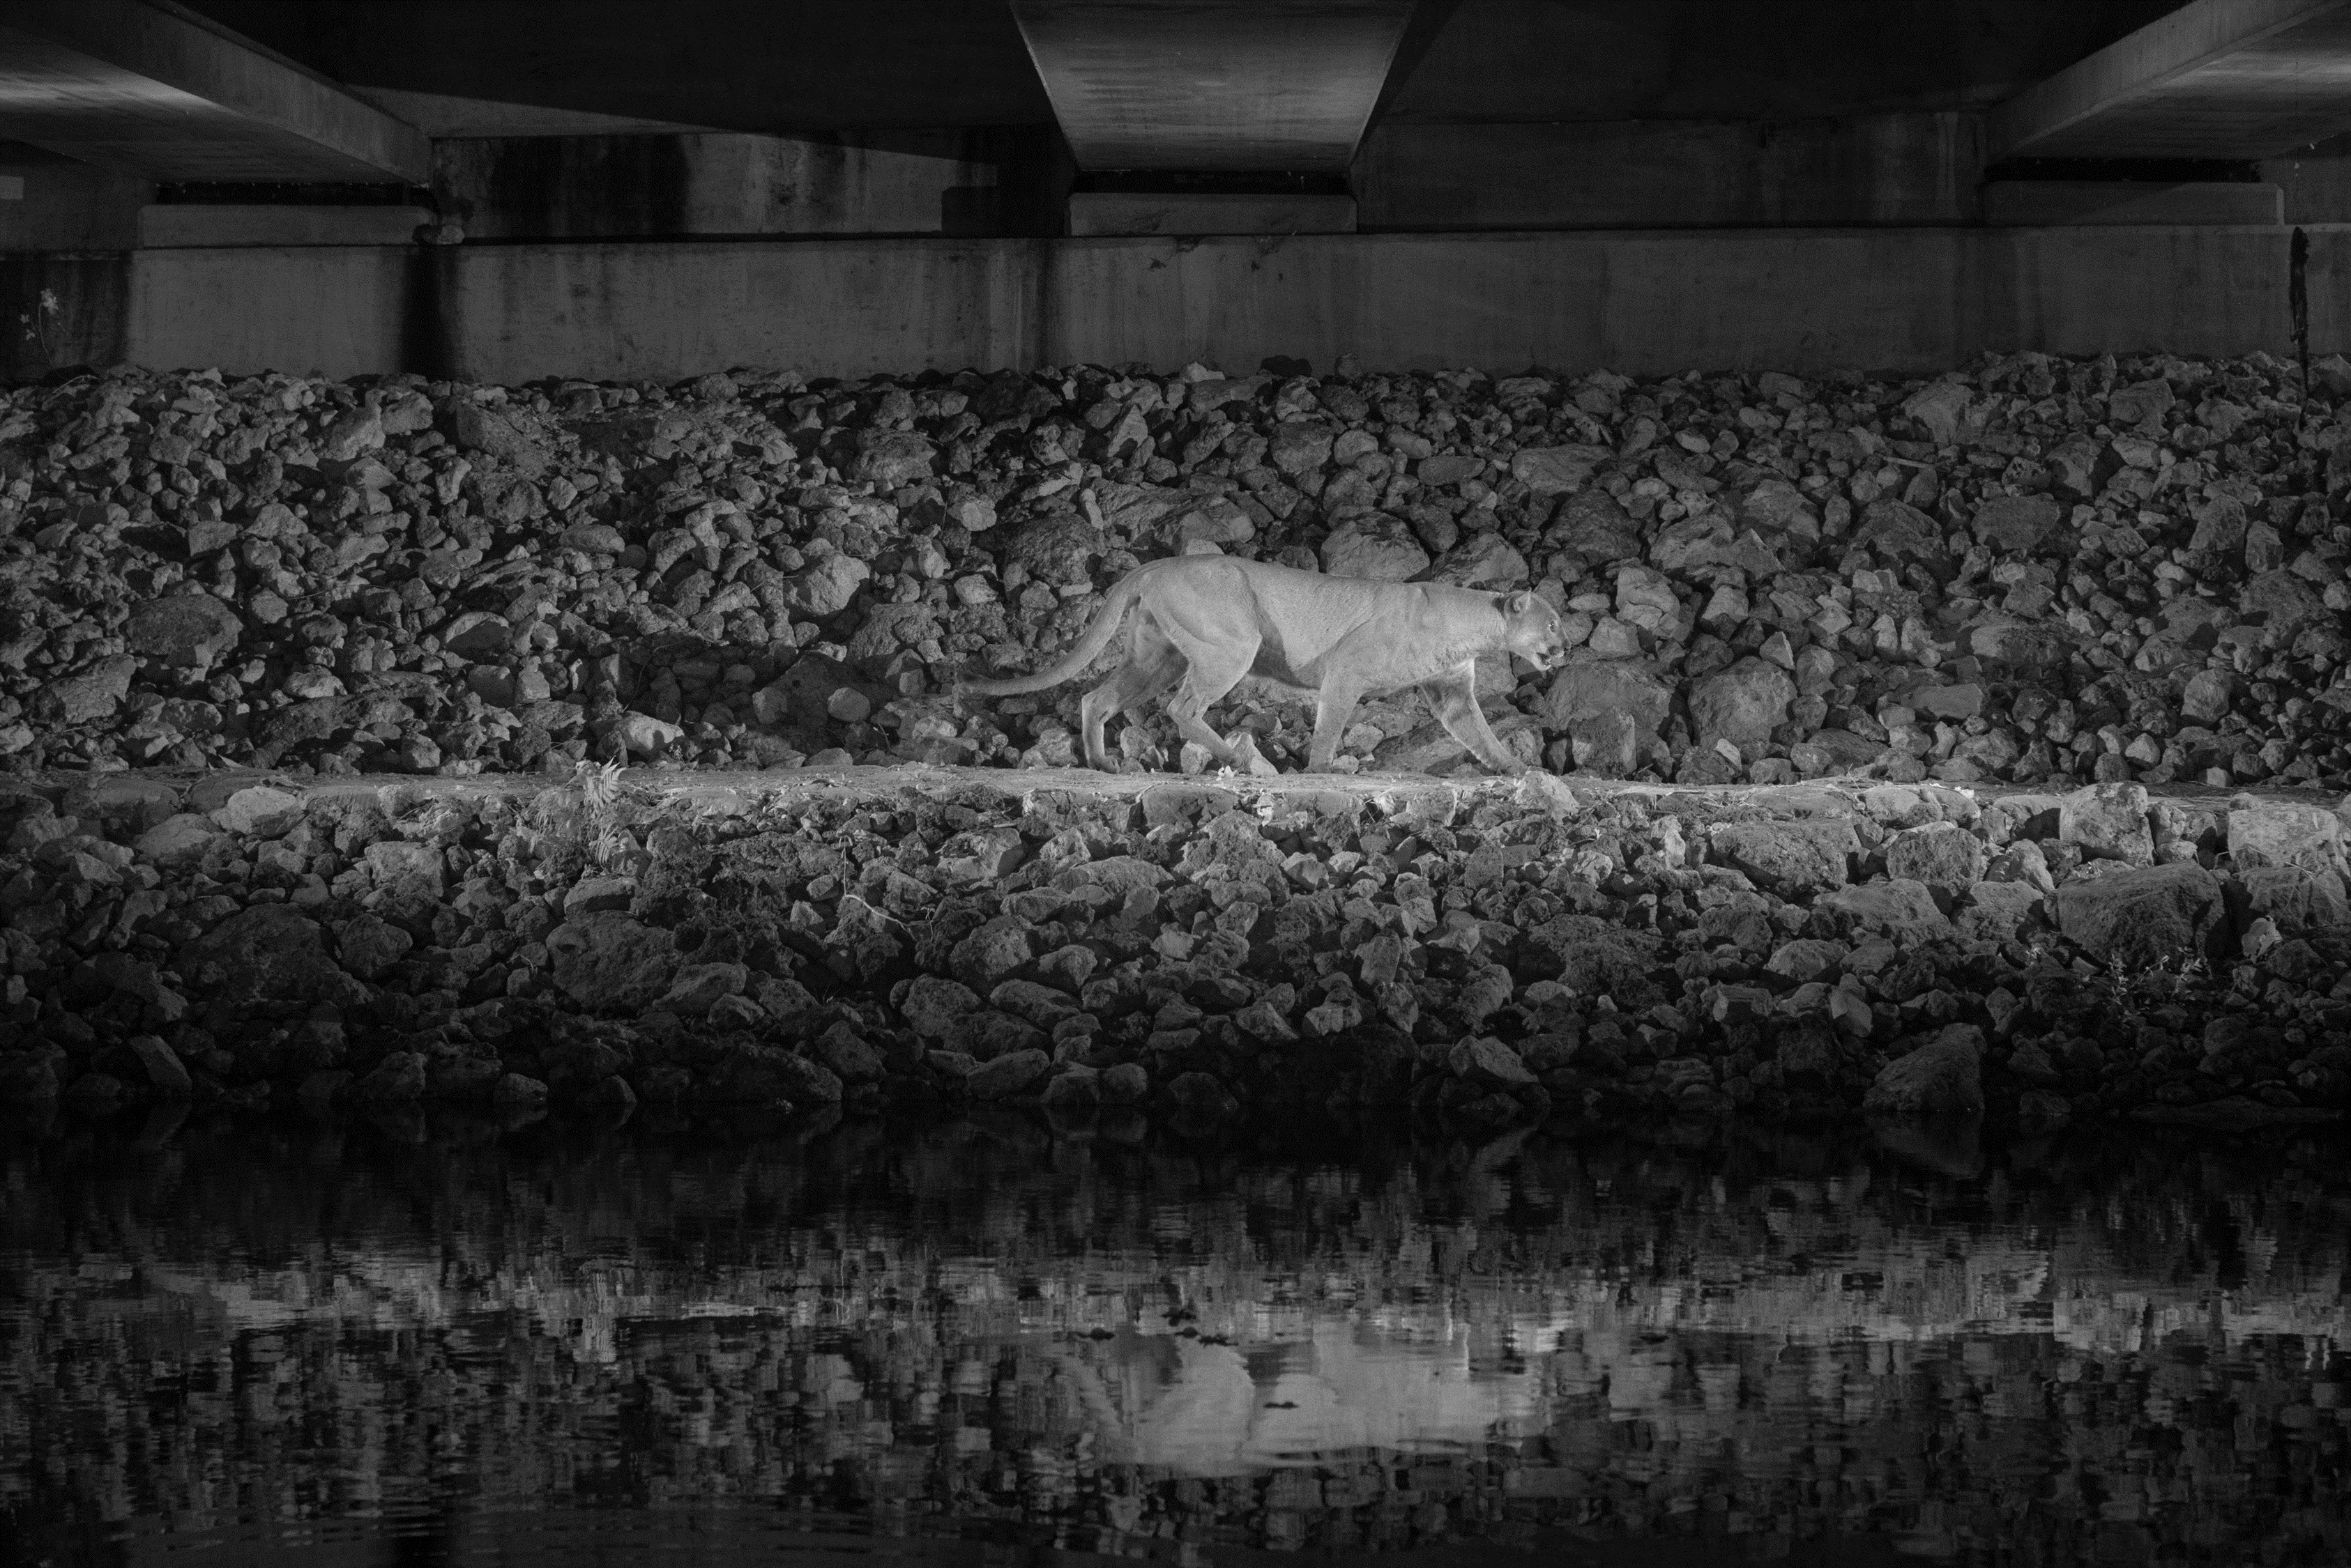
Wildlife Underpasses
© Carlton Ward
© Carlton Ward
© Carlton Ward

Slide 23
Typical Infrastructure Mitigation
Requirements:
Wetlands – mitigation banks, water management district consultations, or mitigation projects
Federally listed species – conservation banks or direct funding to USFWS
State listed species – FWC consultation to avoid impacting these species or gopher tortoise relocation

Slide 24
Suncoast Parkway Mitigation
Requirements:
Withlacoochee State Forest impacts required 1:1 land replacement
  Governed by Section 253.02 FS – now 1.5x the land area utilized or 2x the value
Listed Species Incidental Take permits
  Federal species – Section 10, Endangered Species Act, administered by the US Fish and Wildlife Service
  State species – required consultation with Florida Fish and Wildlife Conservation Commission

Slide 25
Suncoast Parkway Mitigation Plan
Replace lands taken in Withlacoochee State Forest
USFWS Habitat Conservation Plan Permit #TE97201B-0
Eastern indigo snake
Gopher tortoise
FWC Listed Species Incidental Take Permit #16-0007
Short-tailed snake
Gopher frog
Florida pine snake
Southeastern American kestrel
Florida burrowing owl
Florida mouse
Sherman fox squirrel
Homosassa shrew

Slide 26
Consultant Role Suncoast Parkway 2
Initial consultation
Mitigation parcel identification
Landscape familiarity – resources and existing conservation lands
Agency partner contacts
Acquisition phase
Landowner contacts
Real estate – negotiation and due diligence
  EIP Florida
Understanding of DEP acquisition standards
Florida ecology
Florida conservation goals
Outcomes
Florida black bear
Goethe State Forest (Watermelon Pond)
Demonstrated flexibility

Slide 27
FDEP vs. FDOT Acquisition Process
FDEP
Decision to acquire
  Funding
  Ecology
  Politics
Appraisal
Appraisal Review
Negotiation
Contracting
Cabinet approval
Due diligence
Closing
FDOT
Decision to acquire
  Permit
Appraisal
Appraisal Review
Negotiation
Contracting
Due diligence
Closing

Slide 28
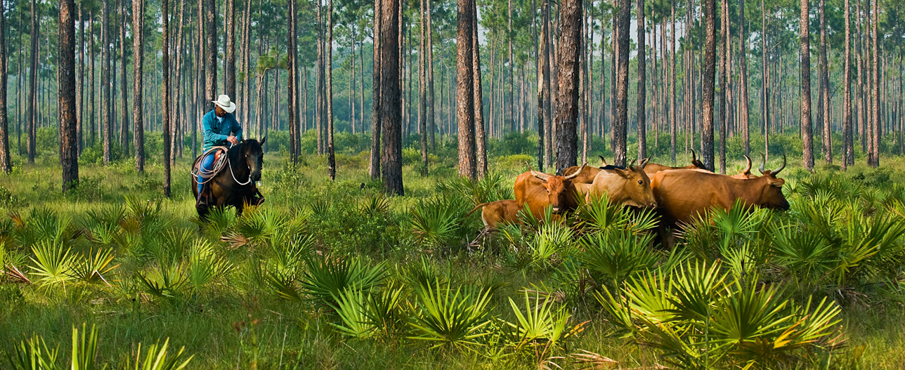

Conclusion
Increasingly, transportation and infrastructure agencies must become partners with the environmental community to achieve landscape conservation objectives

Slide 29
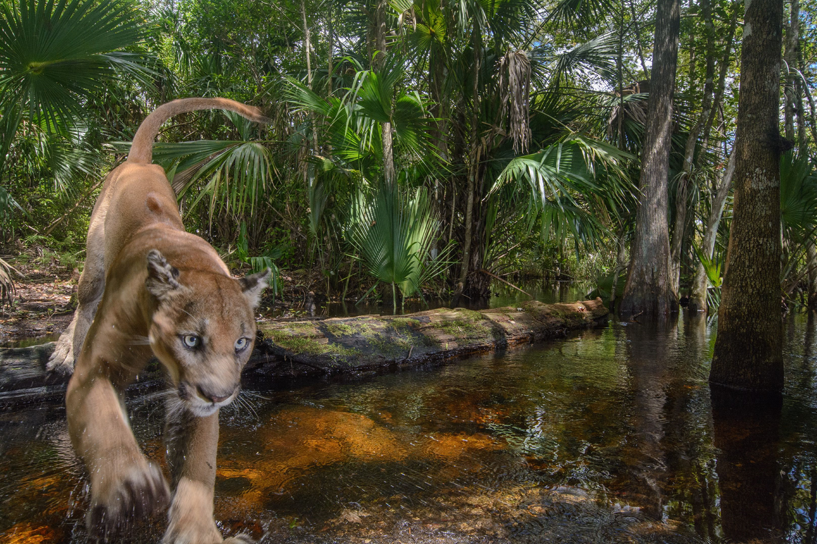
Questions?
©Carlton Ward

